Slide 1
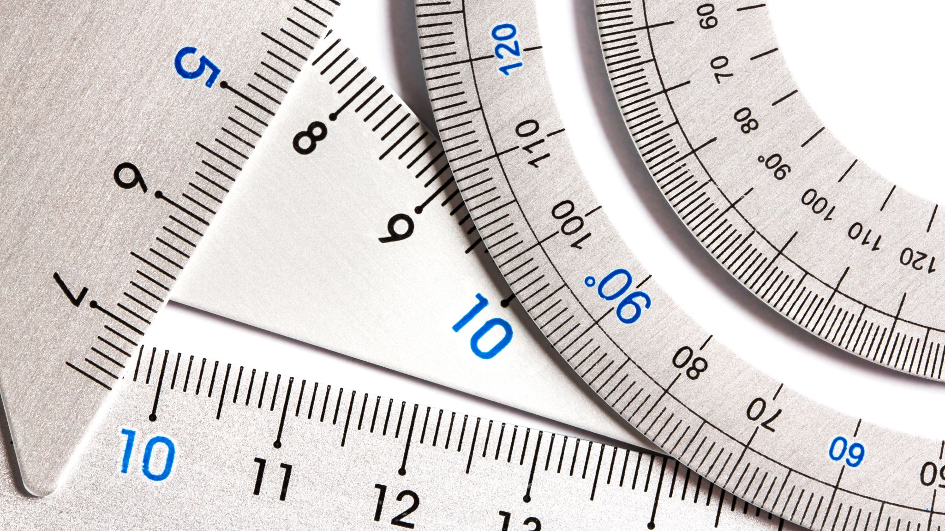
Measuring, Scale & Estimation
Lesson 1 | Measuring Tools

Slide 2
Measuring, Scale & Estimation
Learning Intentions
Success Criteria
Learn about different tools used for measuring.
Learn about the term ‘tolerance’ in terms of measuring.
Learn about Metric and Imperial units.
Learn how to read sizes from a ‘steel rule’
I can name four different measuring tools.
I can explain the term tolerance, and how this applies to different measuring tools.
I can talk about metric and imperial units.
I can read a steel rule to an accuracy of ±0.5mm (within half a millimetre).

Slide 3
Measuring, Scale & Estimation
What tools used for taking measurements can you name?
What do they measure?

Slide 4
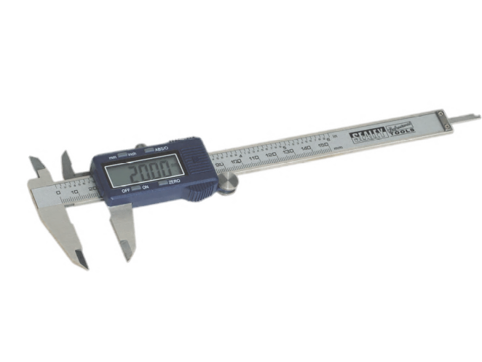
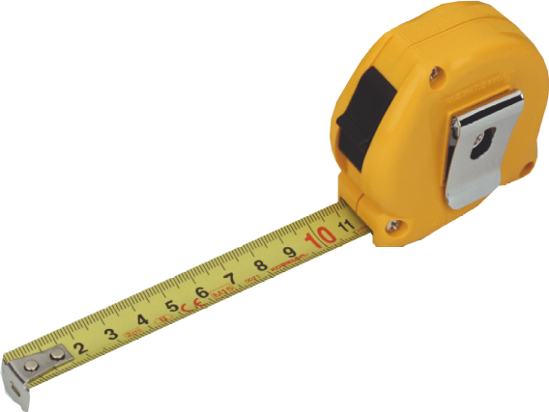
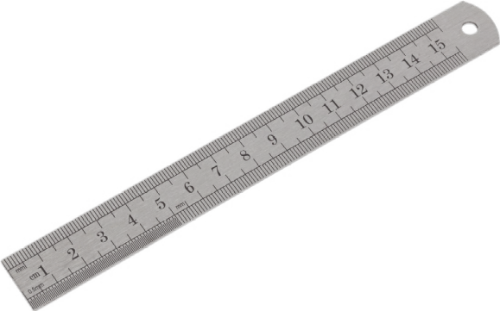
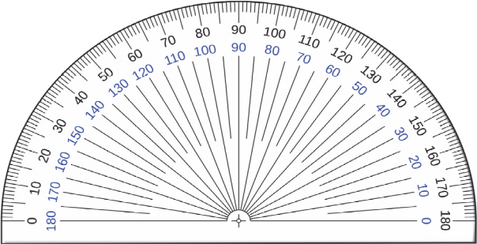
Measuring, Scale & Estimation
What do we know about the tools shown above?

Slide 5
Measuring, Scale & Estimation
METRIC
IMPERIAL
Invented in France.
Used throughout the world.
Used in the UK for most things.
Based on multiples of 10, 100 and 1000.
Millimetres, Metres, Kilometres.
Invented in England.
Still used in the USA and Mexico.
Used in the UK for measuring some things…
Based on various fractions and historic relationships.
Inches, Feet, Yards, Miles.

Slide 6
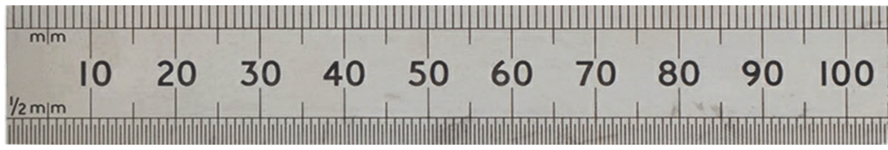
Measuring, Scale & Estimation
Each ‘division’ on a steel rule is 1mm
There are 10mm to 1cm
There are 1000mm to 1m
How accurate you can read/measure something is a ‘tolerance’. It is impossible to be entirely exact. You should be able to read a rule to with ±0.5mm

Slide 7
Measuring, Scale & Estimation
Convert between mm, cm and m is a useful skill.
Remember there are:
10mm = 1cm
1000mm = 1m
100cm = 1m
1000m = 1km

Slide 8
Measuring, Scale & Estimation
I can name four different measuring tools.
I can explain the term tolerance, and how this applies to different measuring tools.
I can talk about metric and imperial units.
I can read a steel rule to an accuracy of ±0.5mm (within half a millimetre).

