Slide 1
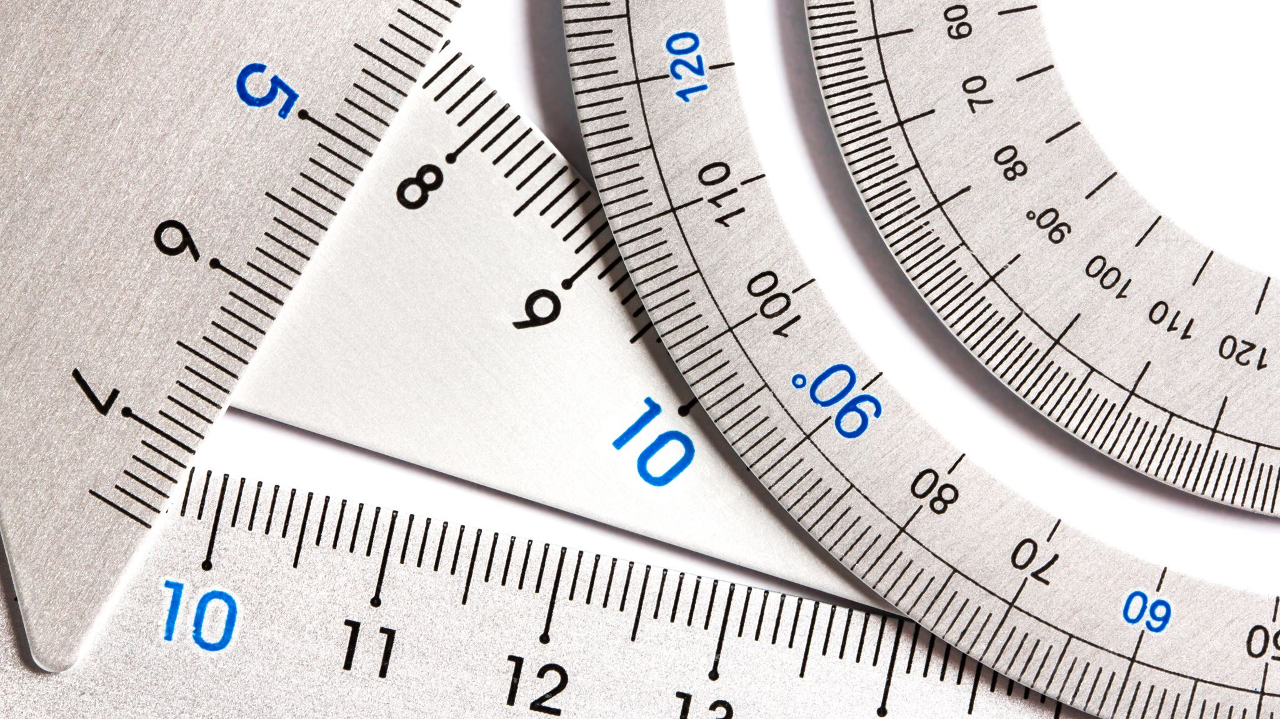
Measuring, Scale & Estimation
Lesson 2 | marking materials, Estimates and scale

Slide 2
Measuring, Scale & Estimation
Learning Intentions
Success Criteria
Learn about marking materials for cutting and shaping.
Understand the term ‘datum’
Understand the term ‘kerf’.
Understand the term ‘estimate’.
Understand the term ‘scale’.
I can mark materials to a required length for cutting, including a kerf gap.
I can estimate a length or area by shading or marking a graphic.
I can scale an object up or down by common ratios.

Slide 3
Measuring, Scale & Estimation
Materials need to be ‘marked out’ before cutting or shaping.
The accuracy of any marking out will determine the quality of the final product.
Measuring and marking is an important step in the making of a product.

Slide 4
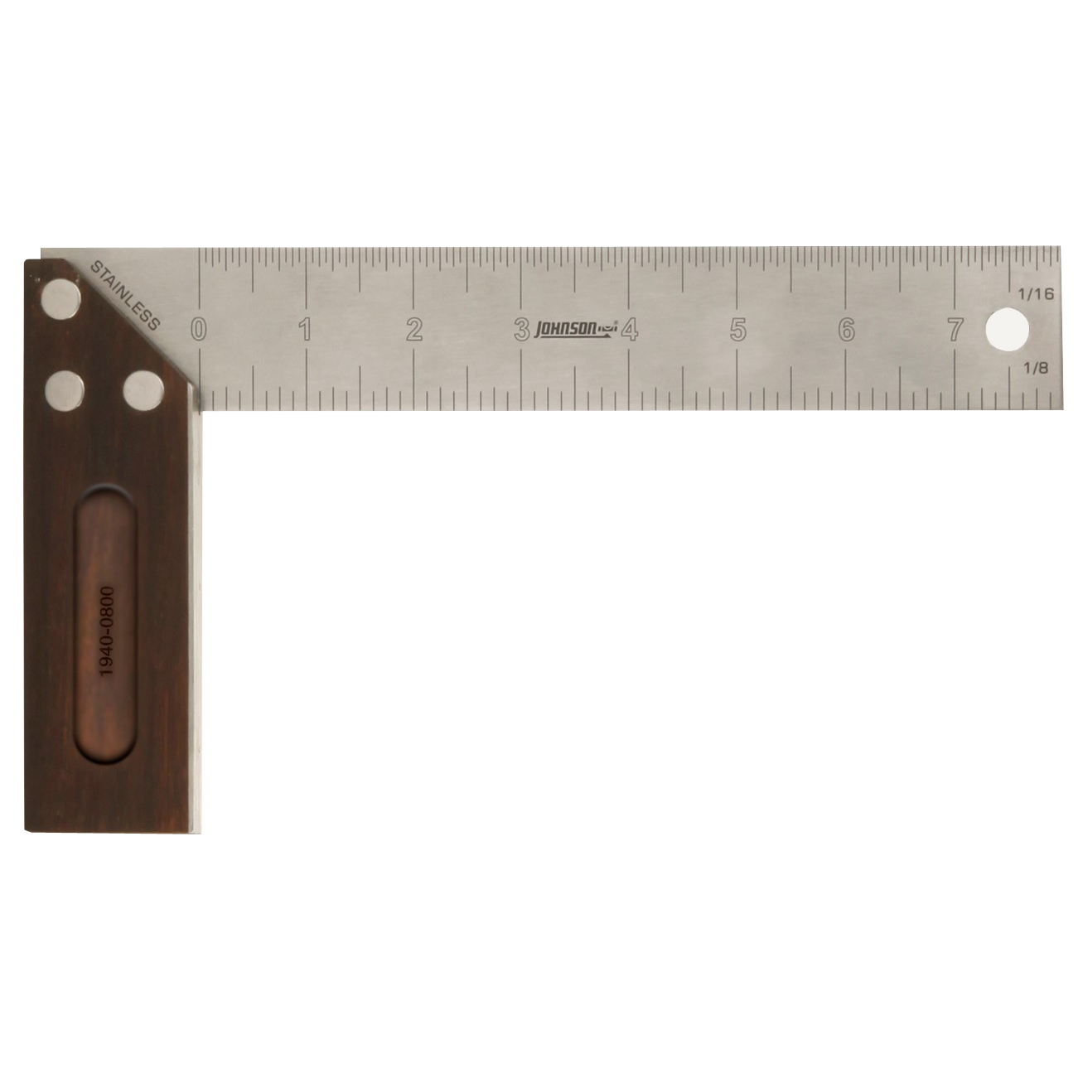
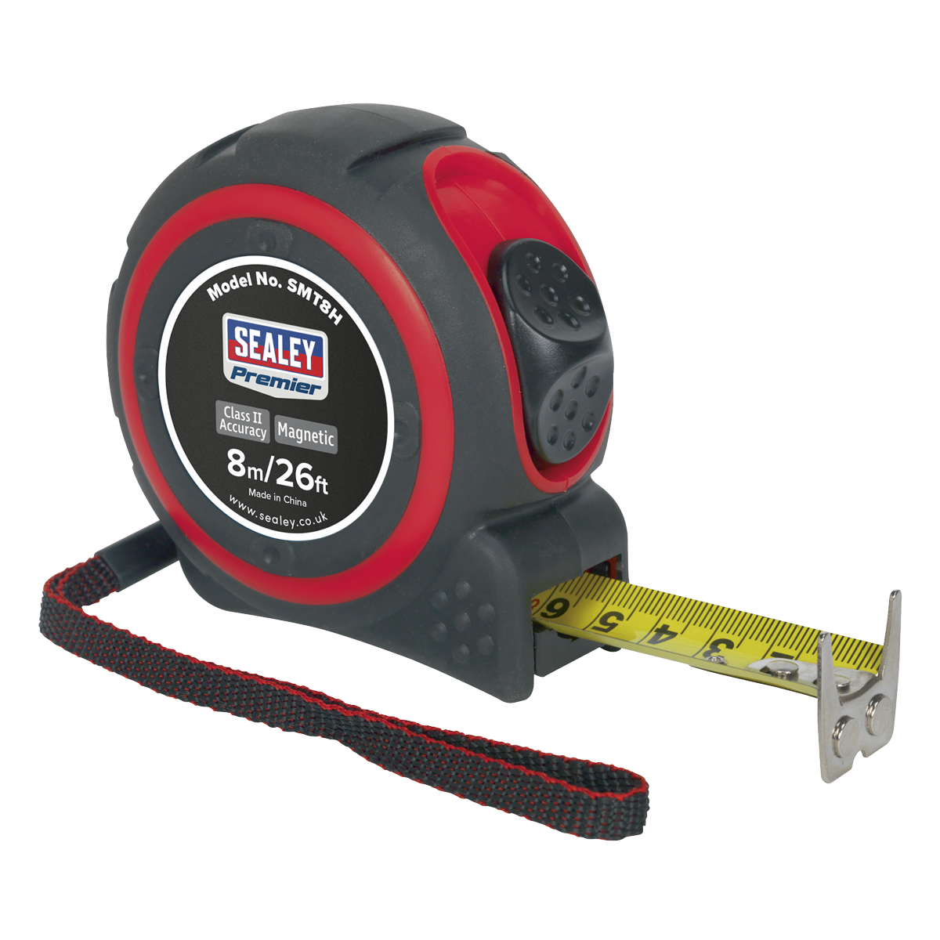
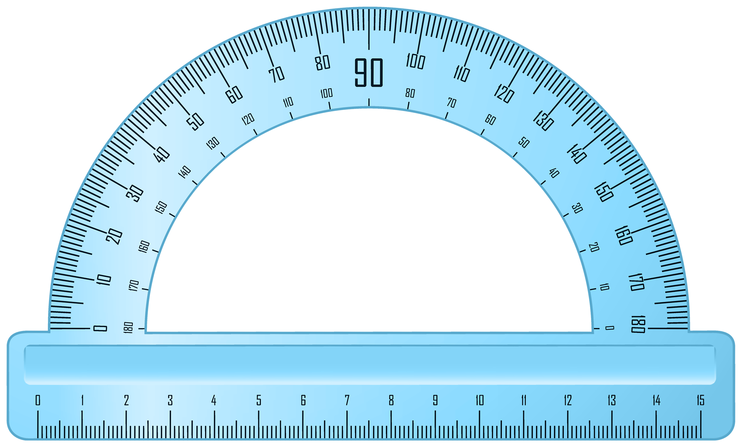
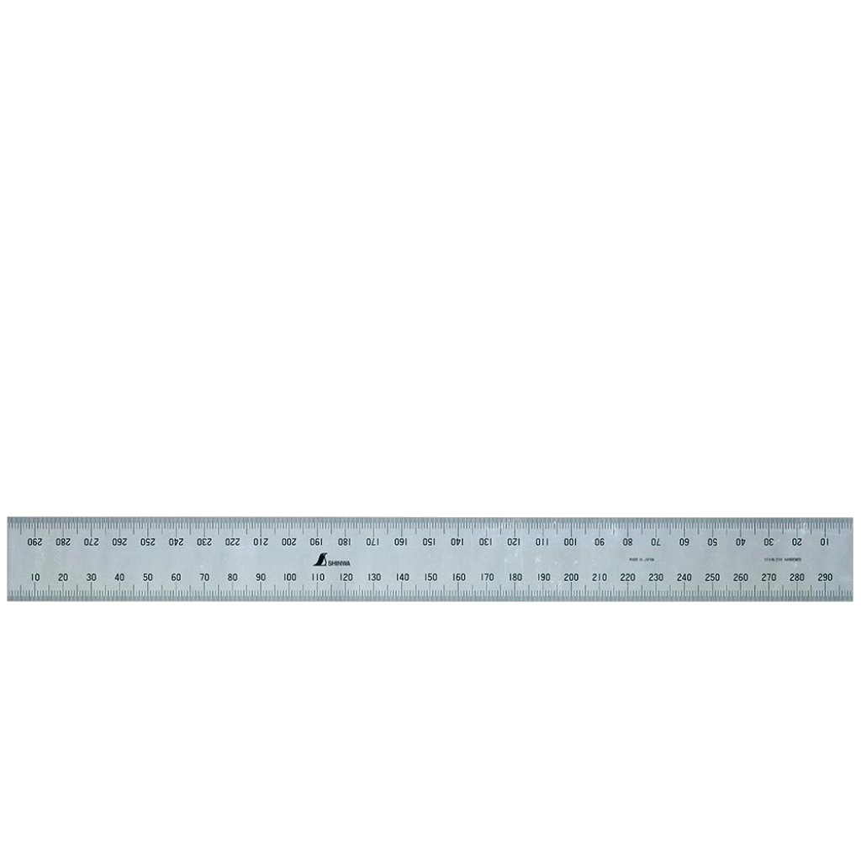
Measuring, Scale & Estimation
What do we know about the tools shown above?

Slide 5
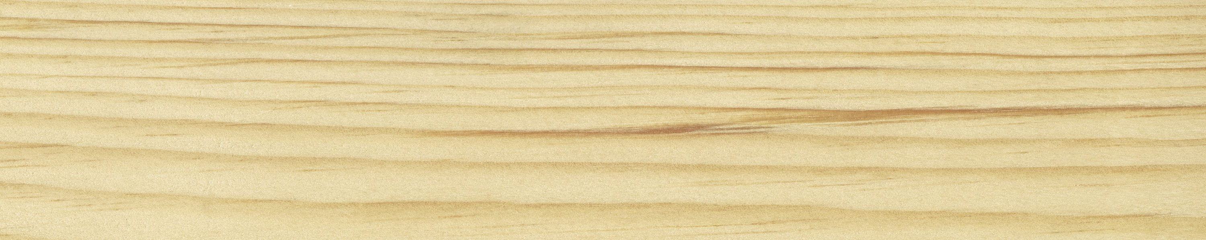
Measuring, Scale & Estimation
Use a Steel Rule to measure from the ‘datum line’.
Make a small mark at the distance required. Try to be very accurate and use a sharp pencil or knife..
Mark a line a small distance from the end of the material.
This line is called a ‘datum’, and where you will take measurements from.
Leave a small gap for cutting between. This is called a ‘Kerf’.
The second line becomes a new datum for marking the next part.

Slide 6
Measuring, Scale & Estimation
measurements
Estimations
Measurements should be accurate.
Measurements can be checked.
Measurements are used for precise work.
Estimations are a form of guess.
The more experienced you are, the more accurate your estimates are likely to be.
Estimates are used for rough work and can be ‘revised’.

Slide 7
Measuring, Scale & Estimation
Scale means making something bigger or smaller by a specific ratio.
Common enlargements include:
2:1
3:1
4:1
5:1
10:1
50:1

Slide 8
Measuring, Scale & Estimation
Scale means making something bigger or smaller by a specific ratio.
Common reductions include:
1:2
1:3
1:4
1:5
1:10
1:50

Slide 9
Measuring, Scale & Estimation
I can mark materials to a required length for cutting, including a kerf gap.
I can estimate a length or area by shading or marking a graphic.
I can scale an object up or down by common ratios.

