Slide 1
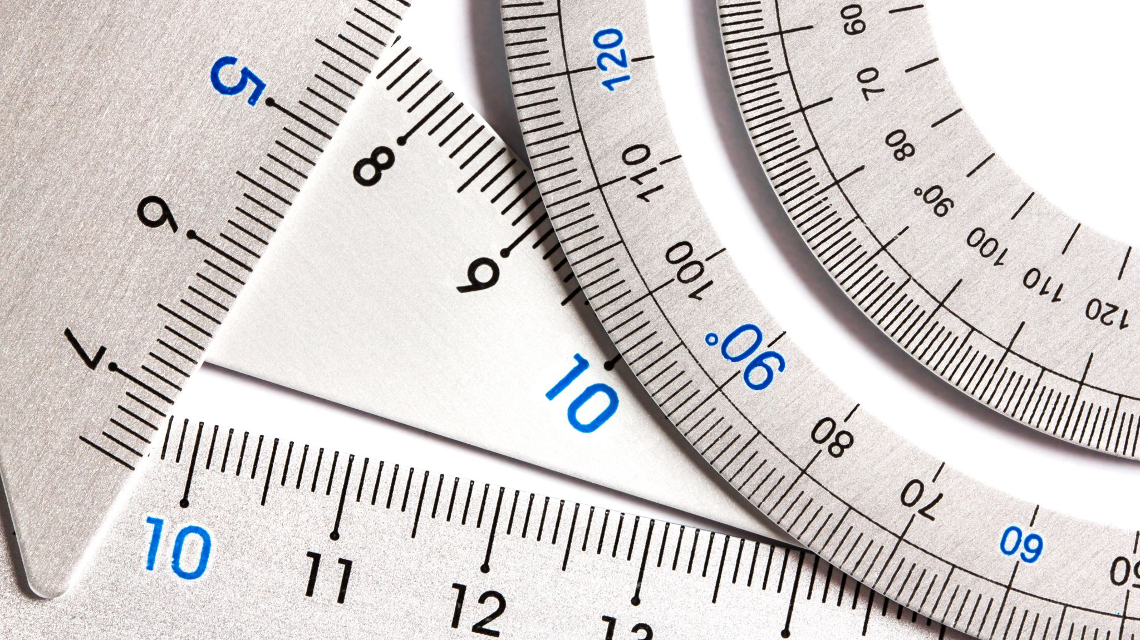
Measuring, Scale & Estimation
Lesson 3 | British Standards & BSI

Slide 2
Measuring, Scale & Estimation
Learning Intentions
Success Criteria
Learn about the British Standards Institute.
Learn about BS.8888 rules for technical drawings.
I can describe the purpose of the BSI.
I can name the features of dimensions on a technical drawing.
I can measure a drawing and add sizes to BS.8888 rules.

Slide 3

Measuring, Scale & Estimation
The British Standards Institute (BSI) is an organisation that creates technical rules that companies and individuals follow.
The rules include lots of things, from Health & Safety to how documents should be stored in an office.
The BSI ‘Kite’ mark is added to products that follow the rules.

Slide 4
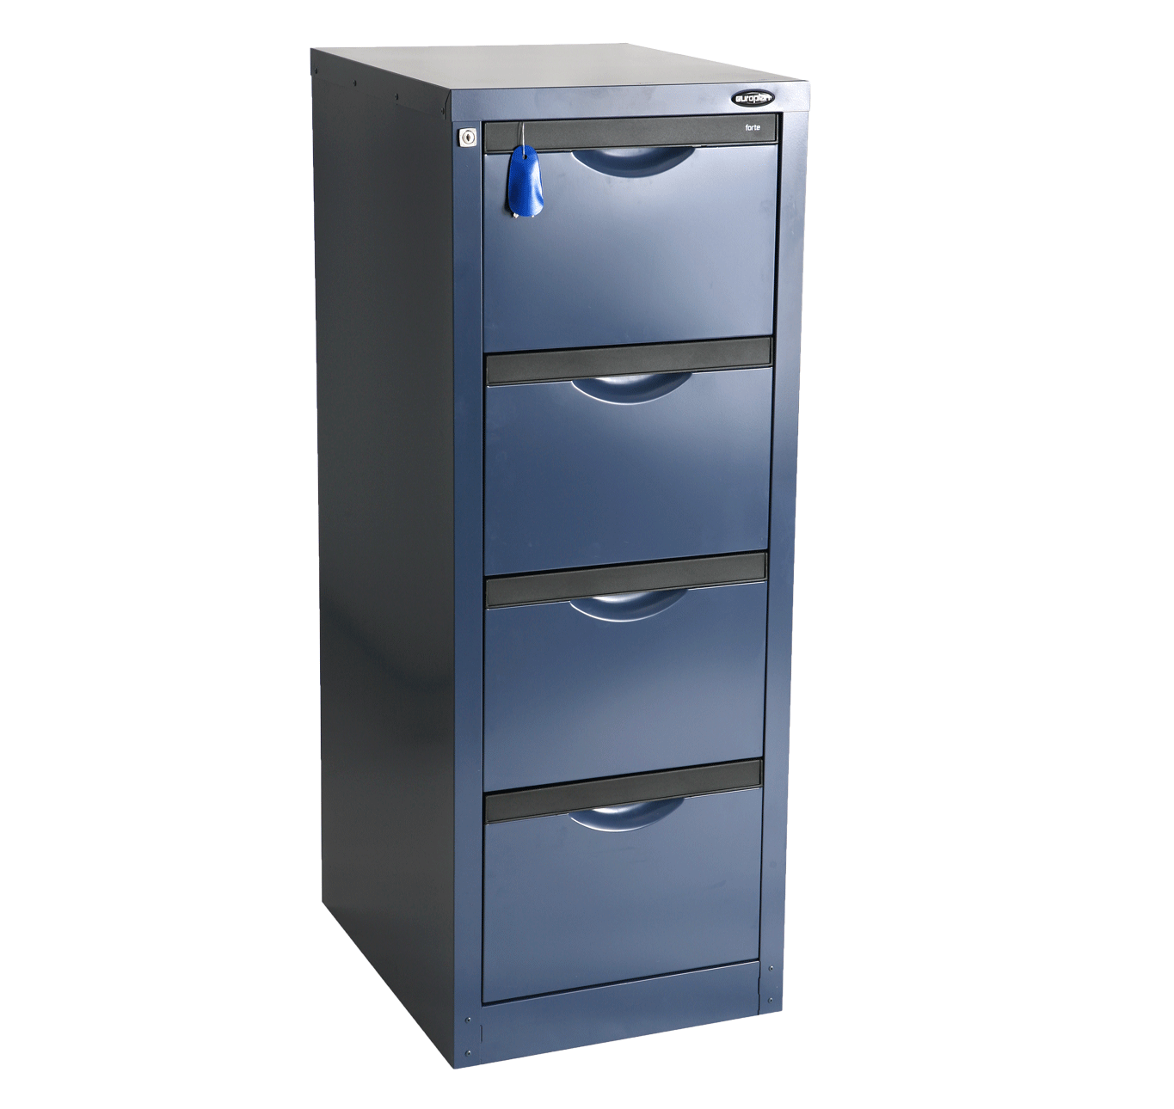

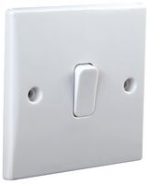

Measuring, Scale & Estimation
The BSI has rules for almost everything. (if they don’t then the ISO does…)
Can you find the rule document for the following products?
Chairs
Switches
Toothpaste
Filing Cabinets
BS ISO 7173
BS EN 60669
ASTM E3288
BS 4438

Slide 5
Measuring, Scale & Estimation
Dimensioning a technical drawing must follow BS.8888 rules.
Extension lines aligned to edges but do not touch!
#
#
Dimension lines connect the extension lines
Arrows must be thin, long and touching the extension lines.
#
#
This drawing would have enough sizes
Sizes go above the dimension lines.

Slide 6
Measuring, Scale & Estimation
I can describe the purpose of the BSI.
I can name the features of dimensions on a technical drawing.
I can measure a drawing and add sizes to BS.8888 rules.
Notes:
Accelerating progress towards a sustainable world | BSI (bsigroup.com) is the website for BSI
https://www.bsigroup.com/en-GB/

